Slide 1
CIDR'17
Optimizing Space Amplification in RocksDB
Siying Dong, mark Callaghan, Leonidas Galanis, Dhruba Borthakur, Tony Savor, Michael Stumm
CHANGWON NATIONAL UNIVERSITY
Notes:
Hello. My name is Minseon Cho from Changwon
Today, I will talk about “Interleaved Data Processing Scheme for Optimizing Tensorflow Framework”

Slide 2
Introduction
RocksDB
Embedded, high-performance, persistent key-value storage system
Developed by Facebook after forking the code from Google's LevelDB
Used in many applications
Based on LSM-trees
Goal with RocksDB
To make the most efficient use of hardware resources
Minimizing space amplification

Slide 3
RocksDB
Components
Memtable: memory
Write-ahead log (WAL) : storage
Write operation logs for recovery
One WAL for each memtable
Sorting string table (SST) : storage
persistent data
Sorted by key
Manifest : storage
Maintains a list of SSTs at each level, corresponding key ranges, other meta data
A log to which changes to th SST information are appended

Slide 4
Log-Structured Merge-Tree
Whenever data is written to the LSM-tree,
Mem-table : in-memory write buffer
Write Ahead Log (WAL)
Data is written to the LSM-tree
At the same time
Memory
Mem-table
Storage
WAL

Slide 5
Log-Structured Merge-Tree
After a write, if the size of the mem-table reaches a predetermined size
Mem-table : in-memory write buffer
Write Ahead Log (WAL)
Sorted Sequence Table (SST)
Immutable
Create new ones
Discard
Memory
Mem-table
Mem-table
Discard
Storage
SST
WAL
WAL

Slide 6
Log-Structured Merge-Tree
I/O
New writes can be processed concurrently to flushing of an older mem-table
All I/O is sequential
Except for the log, only entire files are ever written

Slide 7
Log-Structured Merge-Tree
Compaction
Merge
Level i
SST
SST
SST
Level i+1
SST
SST
SST
SST
SST
SST
Compaction
Level i
SST
SST
Level i+1
SST
SST
SST
SST
SST
SST
SST

Slide 8
Log-Structured Merge-Tree
Compaction
Multi-threaded
Only involves bulk reads and writes → efficient

Slide 9
Log-Structured Merge-Tree
The search for a key
Occurs at each succcessive level until the key is found or it is determined that the key is not present in the last level
At each level,
Locates the target SST by the Manifest File
Locates the target data block within the SST file by using the SST's index block
Looks for the key within the data block
Bloom filters

Slide 10
Log-Structured Merge-Tree
Range queries
Always require a search through all levels
Search the mem-table, then all Level-0 SST, followed by all subsequent levels regarding duplicate keys within the range from lower levels
Prefix Bloom filter can reduce the number of searches.

Slide 11
Space Amplification
B-tree space utilization is poor
The fragmentation causes space amplifiation to be worse
LSM-trees don't suffer from fragmentation
Do not need to write data to be SSD page-aligned
Important to space amplification: How much stale data is yet to be garbage-collected?

Slide 12
Space Amplification
Two strategies to reduce space amplification of RocksDB
Adapting the level sizes to the size of the data
Applying a number of compression strategies

Slide 13
Dynamic Level Size Adaptation
If a fixed size is specified for each level,
In a worse case, space amplification would be larger than 2
Level 0
Level N-1
If the last level is slightly larger than the previous level
Level N (Last level)

Slide 14
Dynamic Level Size Adaptation
If the size of each level is dynamically adjusted,
To be 1/10-th the size of the data on the next level
→ The space amplification will be reduced to less than 1.111 …
Level size multiplier
A tunable parameter within an LSM-tree
The larger the size multiplier is, the lower the space & read amplification, but the higher the write amplification
For most of the Facebook production, a size multiplier of 10 is used.

Slide 15
Compression
Key prefix encoding
Not writing repeated prefixes of previous keys
Reduces space requirements by 3%-17%
Sequence ID garbage collection
The sequence ID of a key is removed if it is older than the oldest snapshot
7 byte large sequence ID does not compress well
Most of the sequence IDs would no longer be needed after the snapshots
Reduces space requirements by 0.03%-23%

Slide 16
Compression
Data compression
Supports several compression algorithms (LZ, Snappy, zlib, Zstandard)
Each level can be configured to use any or none of these compression algorithms
Reduces space requirements down to 40%-25%
To reduce frequency of having to uncompress data, the RocksDB block cache stores blocks in umcompressed form

Slide 17
Compression
Dictionary-based compression
Data dictionaries are important for small data blocks
Smaller blocks have lower compression ratios
Reduces space requirements by 3%

Slide 18
Tradeoffs
Many configuration parameters and options
A number of tradeoffs
For example,
The number of level ↓ space & read amplification ↓, but write amplification ↑
A larger block size improved compression, but negatively affects read amplification

Slide 19
Tradeoffs
Tiered compression
Compression decreases the space requirement, but increases CPU overheads
A strong compression for the last level
No compression at levels 0-2
Lightweight compression for level-3 up to the last level

Slide 20
Tradeoffs
Bloom filters
Reduce I/O operations & CPU over heads, but increases memory usage
No bloom filter at the last level
Prefix bloom filters
Authors developed for range queries
Many range queries are often over a prefix
Allow users to define prefix extractors

Slide 21
Evaluation
Two benchmarks with MySQL
LinkBench based on traces from production databases that store "social graph" data at Facebook Many range queries
TPC-C standard OLTP
Two variants:
The database fit in DRAM
The database did not fit in memory
RocksDB, InnoDB, TokuDB

Slide 22
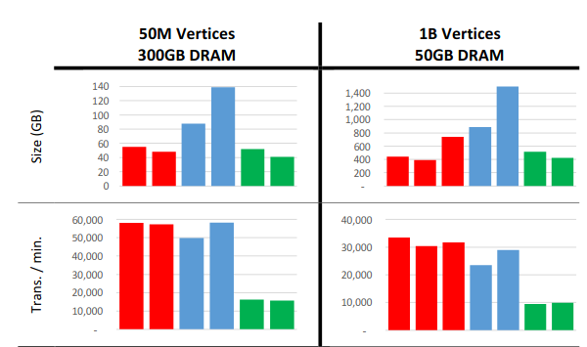

Evaluation
LinkBench
Space usage
Transaction throughput

Slide 23

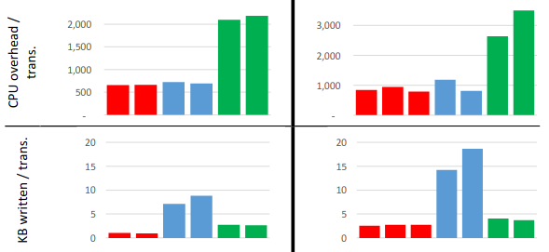
Evaluation
LinkBench
CPU overhead
Write volume

Slide 24
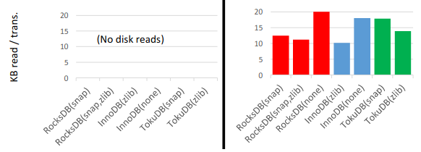
Evaluation
LinkBench
Read volume

Slide 25
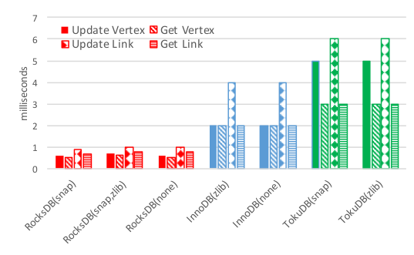
Evaluation
The quality of service
99th percentile latencies for read and write requests

Slide 26
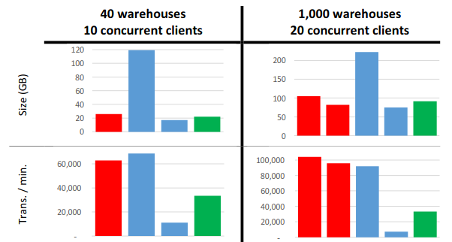

Evaluation
TPC-C
Space usage
Transaction throughput
The TPC-C database grows with the number of transactions

Slide 27

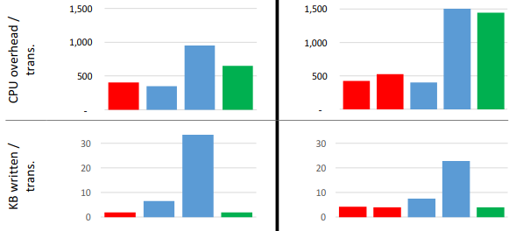
Evaluation
TPC-C
CPU overhead
Write volume

Slide 28
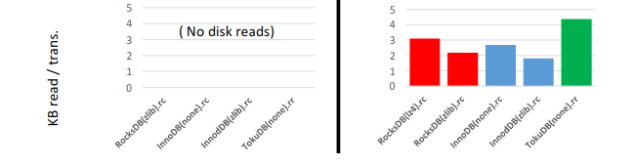
Evaluation
TPC-C
Read volume

Slide 29
Conclusion
Reduce stroage space requirements of RocksDB
Dynamic LSM-tree level size adjustment
Tiered compression
Shared compression dictionary
Bloom filters to key prefixes
Different size multipliers at different LSM-tree levels
Competitive performance on traditional OLTP workloads

